Slide 1
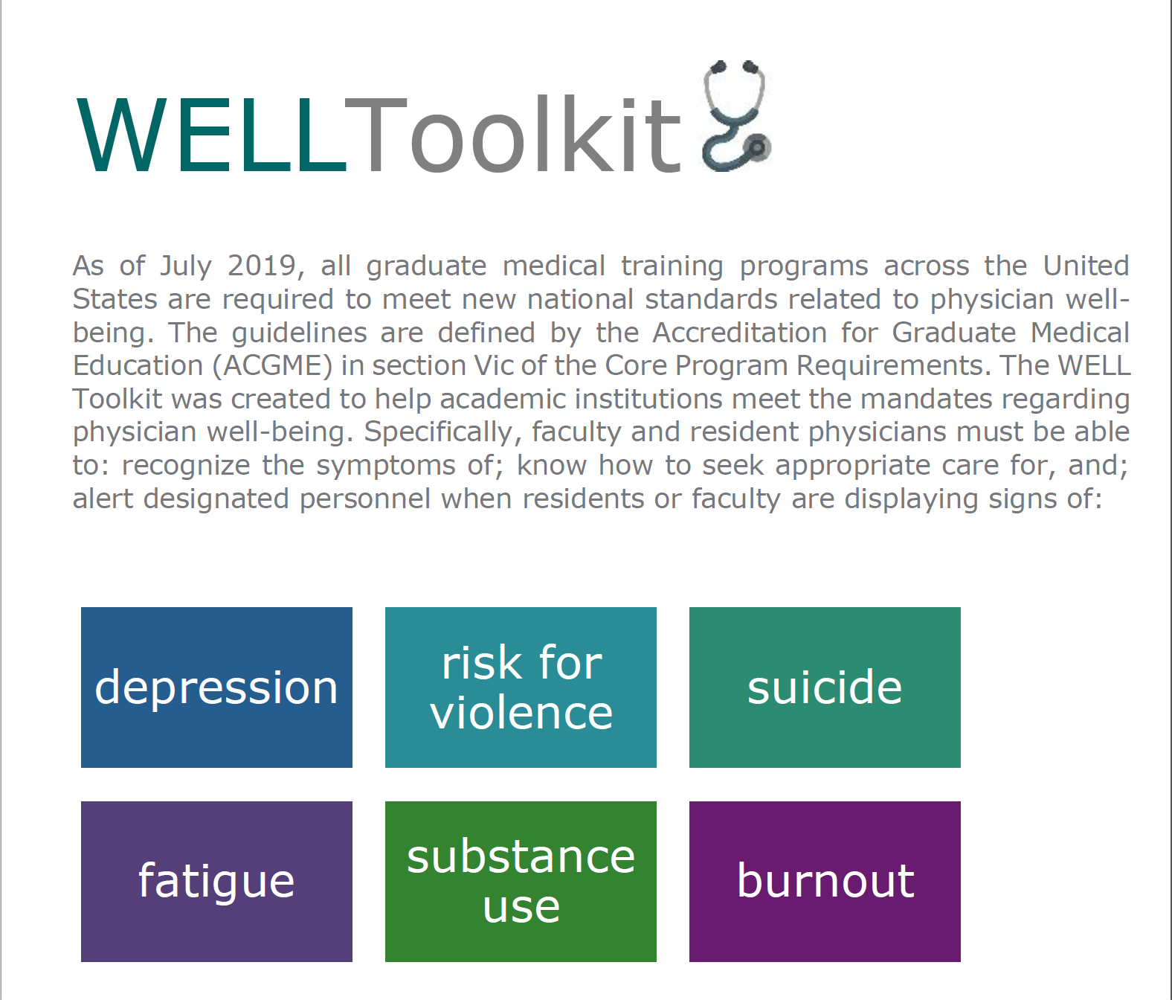
The Appreciative Inquiry
Primary Authors:
Cristin McDermott, MD
Via Winkeller, MD
Version 1.0: Updated June 2020

Slide 2
How to use the WELL Toolkit slides
These slide decks were created by the WELL Toolkit Workgroup in 2020.
You may use these slides individually or as a set for non-commercial purposes. You are welcome to edit this slide deck to customize it to your setting, including the use of your own logo, but please do not substantively change the content of the work.
If you present, reproduce, or distribute these slides, please acknowledge our resource, “WELL Toolkit (2020).”
For additional information and related resources, please visit: https://gmewellness.upmc.com/

Slide 3
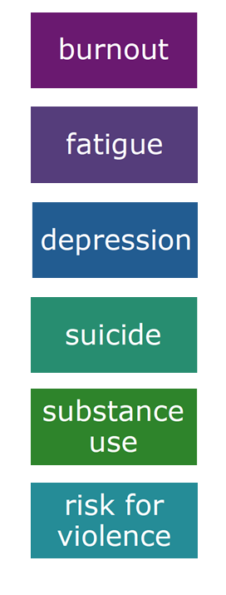

Agenda
Appreciative Inquiry background
  Stages of the 5-D Cycle
  Structuring a Session
  Additional Resources

Slide 4
Learning Objectives
Describe what makes the Appreciative Inquiry a positive needs assessment tool
Name a goal of each of the 5 stages of the Appreciative Inquiry 5-D Cycle
Know how to structure an Appreciative Inquiry session for your own community with the intention to improve physician well-being

Slide 5
“Organizations are, first and foremost, centers of human relatedness and relationships come alive where there is an appreciative eye, when people see the best in one another and the whole, when they share their dreams and ultimate concerns in affirming ways, and when they are connected in full voice to create not just new worlds, but better worlds. By making it possible for every voice to be heard, a life giving process is enacted.”
- The Appreciative Organization
(Harlene Anderson, David Cooperrider, et. al.)

Slide 6

What is an Appreciative Inquiry (AI)?
  Developed at Case Western University in the 1980s
  A strength-based approach to brainstorming and personal and/or organizational change
  The study and exploration of what gives life to systems when they function at their best

Slide 7

Key AI Assumptions
  Questions and conversations about strengths, successes, values, hopes and dreams are transformational
  Build or rebuild around what works

Slide 8
Some Basic AI Tenets
  Recognize the best in the people, organization, and world around us
  Affirm past and present strengths, successes and potentials
  Explore what makes (and has made) our situation great
  Ask questions about what else may be possible
  Be open to seeing, hearing and promoting new possibilities

Slide 9
Simply put…
If we continue to look for problems, we will continue to find problems
If we look for what is/has been the best, and learn from it, we can improve and magnify our successes

Slide 10
Appreciative Inquiry: The 5D Cycle
Define Select and frame the topic of inquiry
Discover Appreciate and value the best of what is
Dream Envision what might be
Design Develop detailed plans for what should be
Deliver Enaction of planned activities what will be

Slide 11

Stage 1: Define
Frame the question
Goals
  Consider what it is you would like participants to focus on (i.e. What vision would you like them to build?)
  Instead of identifying what is lacking, pose the question in a way that activates discussion about what is working well
  The question should be: positive, desirable, and motivational
An Example
  “What interventions are working well to promote resident engagement and well-being within our program?”

Slide 12

Stage 2: Discover
The identification of processes and/or interventions that
currently work well (or have worked well in the past)
Goals
  Understand the best of “what is” and the best of “what has been.”
Questions to consider:
  “Think of a time when you and/or your team was working well. What was in place at that time?
  What helped everyone function at their best?

Slide 13

Stage 3: Dream
The envisioning of processes and/or
interventions that would work well in the future
Goals
  Exploration of “what might be”
  There is no idea too large, and certainly no idea too small
  Consider what works well elsewhere could be used as a means to invite innovation
Questions to consider
  What can we build upon? What else do we need?
  What would help us function at our highest, most productive, collaborative, efficient and meaningful level?

Slide 14

Stage 4: Design
Planning and prioritizing processes and/or
interventions that would work well
Goals
  Make choices about “what should be”
  Work towards improvement and shaping “the ideal”
  Include specifics about how to enact the prioritized changes
Questions to consider
  What is most important to us?
  What resources would we need?
  Who do we need to engage?

Slide 15

Stage 5: Deliver
The implementation of the proposed design
Goals
  Discuss “what will be”
  Create an action plan to support the innovations and ideas generated
Questions to consider
  What are our action items?
  How will we present this information?
  Who needs to know about this?

Slide 16
The Appreciative Inquiry Process
Discover
WHAT IS:
Appreciate what already is
Dream
WHAT MIGHT BE: Envision what else is possible
Design
WHAT SHOULD BE: Prioritize and strategize
Deliver
WHAT WILL BE:
Create and execute what will be

Slide 17

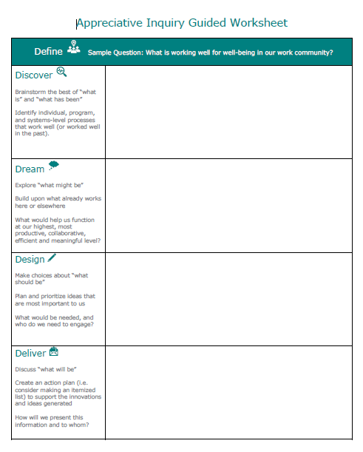
The Appreciative Inquiry Guided Worksheet

Slide 18
Protected Time
Standard rounding times on inpatient units
Clinical teams attend grand rounds together
Health
Community
Administrative Support
Interdisciplinary Social Hours
New role of Well-Being Chief Resident
Physician Assistant hired for overnight H&Ps
Weekly well-being lunch sessions
Automated process for case logging
Quarterly well-being afternoons without didactics
Balint and Process Groups
Weekly events memo to lessen email burden
Resident nutrition taskforce
Online referral lists (e.g. medical, child care)
Sample Outcomes from a Residency Appreciative Inquiry
Notes:
One example of an Appreciative Inquiry conducted by a residency program:
Leadership was surprised to learn that much of what the residents prioritized for their own wellbeing would actually NOT have high cost:
Their time to be valued (and not have rounds interrupted because faculty meetings were scheduled in the morning)
Their supervisors to actively encourage them to attend journal clubs, grand rounds, and educational activities
To be valued as a meaningful member of the team with clear expectations for success
Practical solutions to workflow issues with the EMR and coverage
A physical environment which fosters community and self-care
Frankly, leadership shouldn’t have been surprised, because we know what the contributors to physician burnout are lack of control, long work hours, issues of autonomy, isolation, neglect of self-care, putting others first, etc.!

Slide 19
Structuring a session: WHO & WHERE?
WHO will be involved?
  For example, if looking at resident well-being, would you like it to be resident only? Or does it make sense to have administration present?
  The best brainstorming occurs in smaller groups, so consider splitting into 5-10 individuals per group
  It is helpful to have at least 1 facilitator per small group
WHERE should it occur?
  At or outside of the hospital setting? AI is inherently flexible and can be molded to different settings and situations.

Slide 20
Structuring a session: WHEN?
WHEN (and for how long) should you have it?
  Time allotment depends on the goals
  Ideally it is completed over 2-3 hours though shorter timeframes can work
  Knowing how much time you have in advance will help determine how much time can be spent in each stage
  Be sure to plan the timing out prior to the session
  The Discover, Dream and Design stages can often run long
  It is helpful to have a timekeeper

Slide 21
Structuring a session: HOW, WHAT & WHY?
HOW will you gather the information?
  Having handouts or flipcharts for each group is helpful
  Report-outs from each small group will help create a “master list” of ideas
WHY collect the information and WHAT will you do with it?
  The process requires bidirectional investment (i.e. organization leaders and facilitators must be open to hearing what the participants have to say AND be willing to consider change)

Slide 22

Passing the Baton
In this subsection of the WELL Toolkit you will find additional materials (e.g. AI Summary Sheet) to embark on your own Appreciative Inquiry…
GIVE IT A TRY!

Slide 23

Appreciative Inquiry Resources
AMA Steps Forward
Appreciative Inquiry Principles
https://edhub.ama-assn.org/steps-forward/module/2702691
Positive Psychology Program
Appreciative Inquiry Interview Questions
https://positivepsychologyprogram.com/appreciative-inquiry-questions
The Center for Appreciative Inquiry
https://www.centerforappreciativeinquiry.net

Slide 24

Thank you!
For more information:
The WELL Website https://gmewellness.upmc.com
Please email questions to:
Sansea Jacobson, M.D. jacobsonsl@upmc.edu
Vu Nguyen, M.D.
nguyenvt3@upmc.edu
Notes:
To make inquires, provide feedback, or to learn how you can contribute to future versions of the WELL Toolkit, please contact the UPMC GME WELL Subcommittee Co-Chairs: Sansea L. Jacobson, MD (jacobsonsl@upmc.edu) and Vu T. Nguyen, MD (nguyenvt3@upmc.edu).

