Slide 1
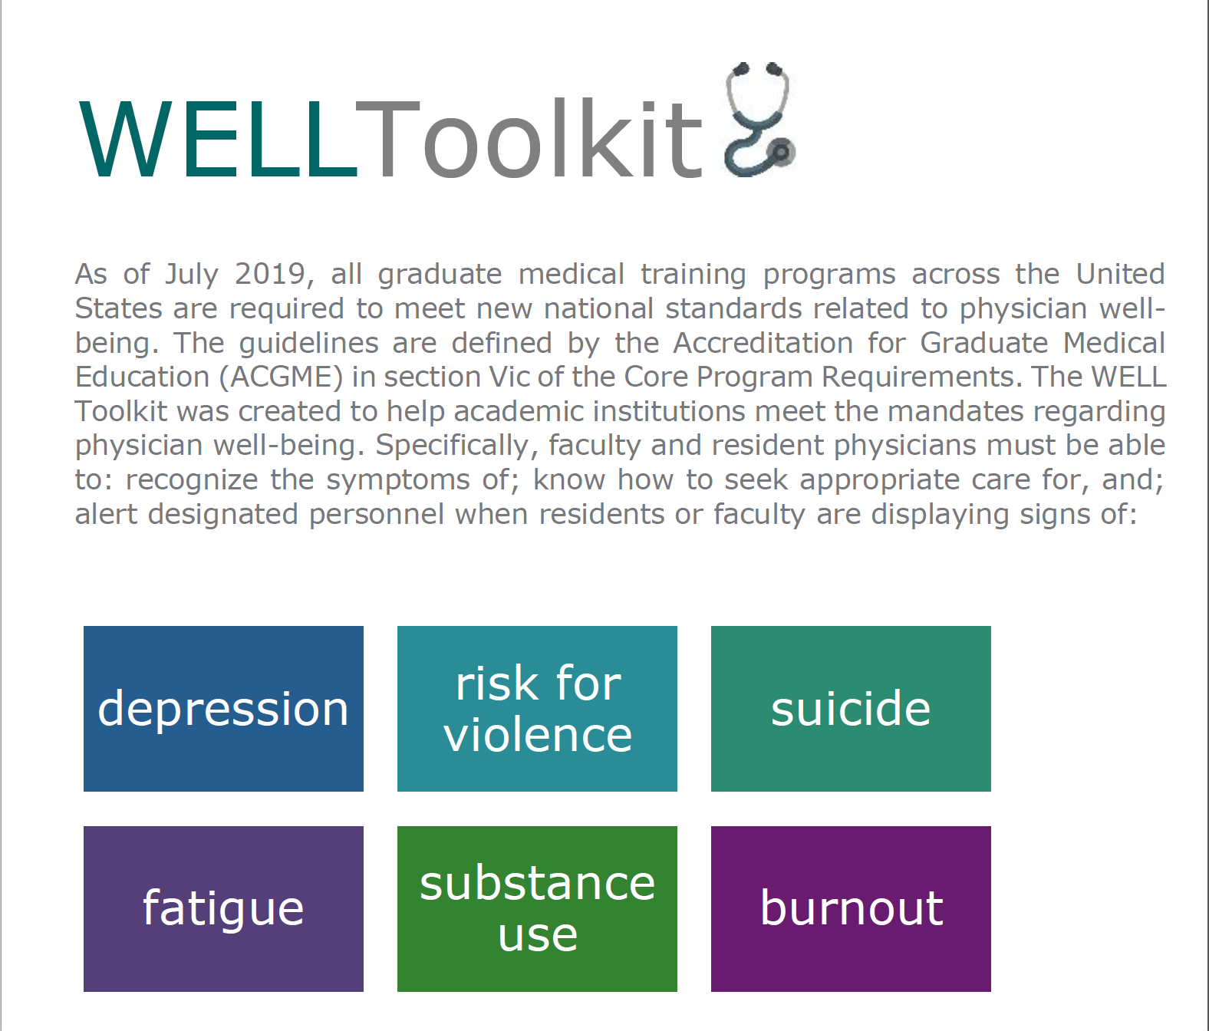
Brief Introduction to the WELL Toolkit
Version 1.0: Updated June 2020
Notes:
Welcome! This slide set serves as a brief introduction to Version 1.0 of the WELL toolkit.

Slide 2
How to use the WELL Toolkit slides
These slide decks were created by the WELL Toolkit Workgroup in 2020.
You may use these slides individually or as a set for non-commercial purposes. You are welcome to edit this slide deck to customize it to your setting, including the use of your own logo, but please do not substantively change the content of the work.
If you present, reproduce, or distribute these slides, please acknowledge our resource, “WELL Toolkit (2020).”
For additional information and related resources, please visit: https://gmewellness.upmc.com/
Notes:
Guidelines on the use of the WELL Toolkit.

Slide 3
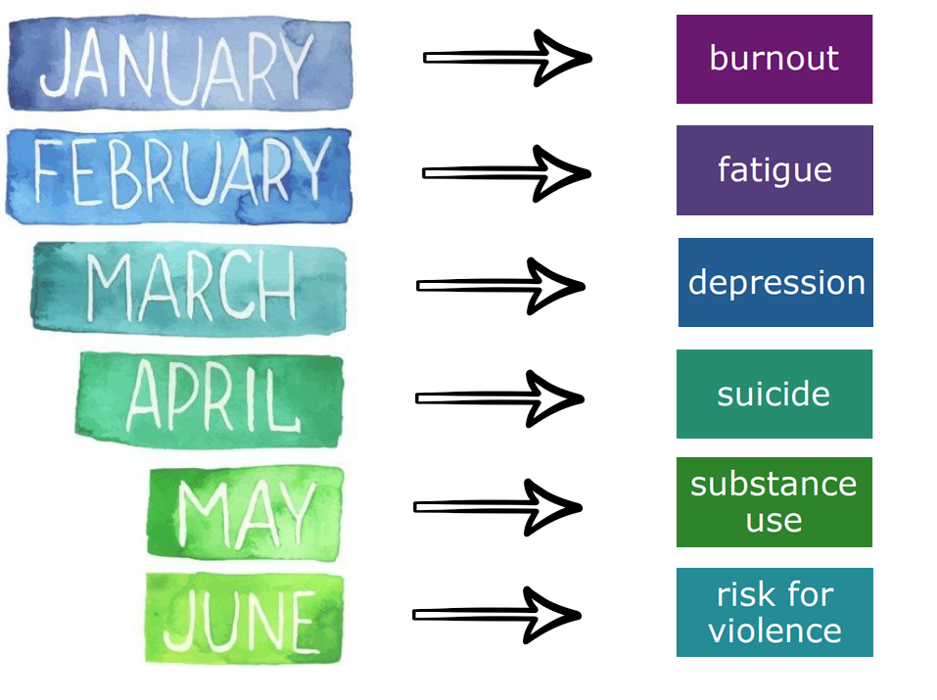
Agenda
WELL Toolkit Mission
Design and Format
Contents of the Subsections
Authors and Collaborators
Notes:
This presentation will introduce educators to the mission, format and content of the WELL Toolkit, Version 1.0.

Slide 4
Learning Objectives
Be aware of the new ACGME core program requirements on physician well-being
Have an awareness of how the WELL Toolkit can help meet the new national guidelines
Be introduced to the content of each of the subsections of the WELL Toolkit
Notes:
Learning Objectives for this presentation

Slide 5
WELL Toolkit helps meet ACGME Requirements
  Recognize symptoms of:
  Know how to seek appropriate care for:
  Alert designated personnel when residents
  or faculty are displaying signs of:
In the 2019-20 academic year, the UPMC GME leadership team in coordination with content experts across the nation launched the WELL Toolkit. This free online resource was designed to help physician educators across all discipline meet the new physician wellness ACGME Core Program Requirements in Section VIc for ALL physician faculty and trainees nationwide.
Notes:
As of July 2019, all graduate medical training programs across the United States are required to meet new national standards related to physician well-being. The guidelines are defined by the Accreditation Council for Graduate Medical Education (ACGME) in section VIc of the Core Program Requirements. The WELL Toolkit was created to help academic institutions meet the mandates regarding physician well-being. Specifically, as per the ACGME, attending, fellow and resident physicians must be able to: recognize the symptoms of; know how to seek appropriate care for, and; alert designated personnel when residents or faculty are displaying signs of: fatigue, burnout, depression, suicide, substance use, and risk for violence.

Slide 6
Mission
Designed by physicians for physicians
Meets ACGME requirements meaningfully
Practical, relevant and easily-digestible
Modules informed by adult-learning theory
Evidence-based content specific to physicians
Geography-specific content can be used as template
FREE and easy online download
Notes:
The overarching mission was to create a product that would improve the likelihood that physicians will seek help when they are struggling. The contents of the WELL Toolkit are free and downloadable online. While some of the materials are geography-specific, the modules are intended to be easily modifiable by outside institutions. The intention was not to simply meet the new national guidelines, but to do so meaningfully with educational modules that are informed by adult learning theory, practical, and easily digestible. While there are many well-being resources already in existence, this online toolkit was designed for physicians by physicians, with content that is evidence-based and specific to physicians and the practice of medicine.

Slide 7

Contents
Easy for non-experts to teach out-of-the-box
One-Page Flyers
FAQs
Flowsheets
PowerPoints
Online Resources
Screening Tools
Case Scenarios
Annotated Bibliographies
Notes:
Educators need not be content experts to be able to engage physician audiences with these materials. The format includes PowerPoints, FAQs, flowsheets, screening tools, case scenarios, annotated bibliographies, one-page flyers, interactive session guides, and supporting resources available online.

Slide 8
Content: Introduction Subsection
Overview:
  WELL Toolkit Overview (Please read this first)
Presentations:
  Brief Introduction to the WELL Toolkit
  How to decrease barriers to physician help-seeking
  UPMC Guide on what happens when a physician seeks help*
  UPMC Physician Well-Being Leadership and Initiatives*
Resources:
  10 Tips for Physician Supervisors
  UPMC Well-Being Resource Guide – Resident Version*
  UPMC Well-Being Resource Guide – Attending Version*
*UPMC Specific
Notes:
Follows is an outline of the WELL Toolkit contents as well as acknowledgement to our many outstanding authors and collaborators without whose generosity this project would not be possible. You will notice that there are some contents that are labeled “UPMC Specific” – We welcome educators and well-being champions from outside institutions to customize these resources to reflect policy and resources at your home institutions. The first section of the toolkit is the “Introduction.”

Slide 9

Content: Burnout Subsection
Presentations:
  Physician Burnout
  Appreciative Inquiry
  Positive Psychology
Resources:
  Appreciative Inquiry Guided Worksheet
  PEERS Signature Strengths Exercise
  PEERS Living by your Values Exercise
  PEERS ABCs of CBT Exercise
  PEERS Savoring Exercise
  Making the Case for Well-Being
  Physician Burnout Annotated Bibliography
Notes:
Contents of the Burnout Subsection

Slide 10
Content: Fatigue Subsection
Presentations:
  Sleep in Medical Training
Resources:
  Physician Fatigue FAQ
  Physician Fatigue Flyer
  Physician Fatigue Case Scenarios
  Fatigue Screening Tools
Notes:
Contents of the Fatigue Subsection

Slide 11
Content: Depression Subsection
Presentations:
  Recognizing the Signs of Depression in Physicians
  Small Group Activities on Physician Depression
  How UPMC Physicians Can Seek Help for Depression*
Resources:
  Physician Depression Scenario for facilitator
  Physician Depression Scenario for learner
*UPMC Specific
Notes:
Contents of the Depression Subsection

Slide 12
Content: Suicide Subsection
Presentations:
  Physician Suicide Prevention
Resources:
  Physician Suicide FAQ
  Suicide Prevention Online Resources
Notes:
Contents of the Suicide Subsection

Slide 13
Content: Substance Use Subsection
Presentations:
  Physicians and Substance Use
Resources:
  UPMC Physician Substance Use Disorder Flyer*
  UPMC Physician Substance Use Disorder Flowsheet*
  Physician Substance Use – Selected Articles
*UPMC Specific
Notes:
Contents of the Substance Use Subsection

Slide 14
Content: Risk for Violence Subsection
Presentations:
  Prevention of Workplace Violence in Medical Settings
  Microaggressions (Part 1)
  Microaggressions (Part 2)
Resources:
  Risk for Violence – Selected Articles
Notes:
Contents of the Risk for Violence Subsection

Slide 15
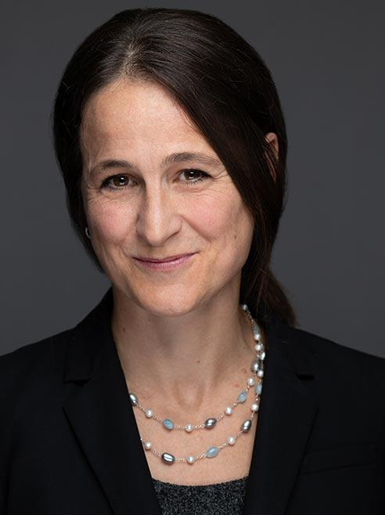
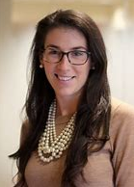
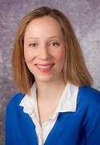
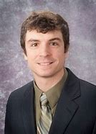
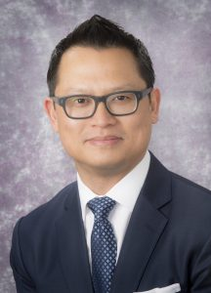
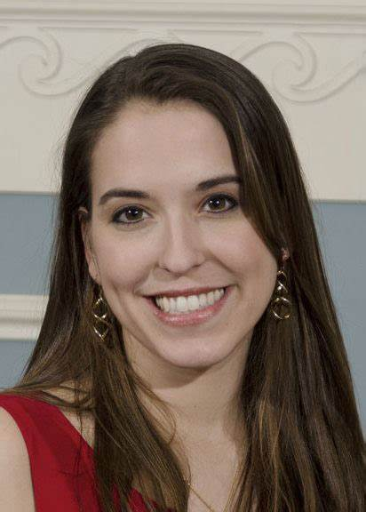
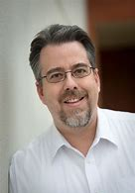
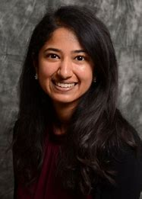
WELL Subcommittee
UPMC Graduate Medical Education WELL (Wellness, Environment, Learning and Living) Subcommittee Serve the 1700+ resident and fellow physicians at the University of Pittsburgh Medical Center
WELL Toolkit Leadership
The WELL Co-Chairs and six additional UPMC physicians served as subgroup leads for the six WELL Toolkit topics Each subgroup had consultants and content experts totaling >80 contributors from across the nation
Sansea Jacobson, MD
(Psychiatry)
WELL Co-Chair
Suicide Lead
Cristin McDermott, MD
(Peds/Psych)
Burnout Co-Lead
Via Winkeller, MD
(Peds/Psych)
Burnout Co-Lead
Phillip Adams, DO
(Anesthesia)
Substance Lead
Vu Nguyen, MD
(Plastic Surgery)
WELL Co-Chair
Fatigue Lead
Neeta Shenai
(Psychiatry)
Depression Co-Lead
Robin Valpey, MD
(Psychiatry)
Depression Co-Lead
Jack Rozel, MD
(Psychiatry)
Violence Lead
Notes:
The UPMC Graduate Medical Education WELL (Wellness, Environment, Learning and Living) Subcommittee serve the 1700+ resident and fellow physicians at the University of Pittsburgh Medical Center. The WELL Toolkit leadership consisted of the WELL Co-Chairs as well as six additional UPMC physicians. Each subgroup had consultants and content experts totaling >80 contributors from across the nation.

Slide 16
Gratitude to the WELL Toolkit contributors
WELL would like to thank our content contributors and consultants:
Introduction: Sansea Jacobson (Lead), Vu Nguyen, Andres Martin, Julie Chilton, Ryan Augustin, Gregory Bump, Jennifer Berliner
Burnout: Cristin McDermott (Lead), Via Winkeller (Lead), Amanda Downey, Victoria Deans, Priyanka Amin, Jeffrey Magill, Amanda Downey, Allison Schroeder, Scotty Chapman, Cordelia Ross, Jordyn Feingold, Anne Hart, Shreya Nagula, Asher Simon, Daniya Kamran-Morley, Lilian Emlet, Sansea Jacobson, Eva Szigethy, Carol Bernstein
Fatigue: Vu Nguyen (Lead), Daniel Buysse, Edwin Williamson, Mary Margaret Populo, Jennifer O'Donohoe, Alaa Elnajjar, Adriana Wegrecki, Lilian Emlet
Depression: Robin Valpey (Lead), Neeta Shenai (Lead), Kristi Kleinschmit, Katherine Soe, Marisa Moreta, Ryan Peterson, Carolyn Wiersma, Sansea Jacobson
Suicide: Sansea Jacobson (Lead), Brian Kurtz, Christine Moutier, David Brent, Ellen Koch, Tiffany Painter, Maggie Mortali, Victoria Deans, Jeff Magill, Julie Chilton
Substance Use: Phillip Adams (Lead), Jody Glance, Nancy McKee, Victoria Deans, Alicia Fairman, Alex Israel, David Metro, Heather Reading, Sansea Jacobson
Risk for Violence: Jack Rozel (Lead), Priyanka Amin, Lindsay Nakaishi, Alda Maria Gonzaga, Naudia Jonassaint, Evelyn Reis
WELL is grateful for the institutional support of:
UPMC Physician THRIVE, UPMC WorkPartners and LifeSolutions, The University of Pittsburgh Department of Psychiatry, The University of Pittsburgh Department of Anesthesiology
WELL would like to thank our UPMC GME leadership and collaborators:
Vikas Agarwal, Andrew Buchert, Gregory Bump, Al Ciocca, Gabriella Gosman, Melinda Hamilton, Wendy Helkowski, Sansea Jacobson, Frank Kroboth, William Lamb, Kristin Lasher, Julie McCausland, Vu Nguyen, Dennis Phillips, Anna Roman, Jacqueline Weaver-Agostoni, Allan Wolfson, Samantha Cascone, Brittany Rosser, Brandon Doughty, Heather Reading, and the resident and attending members of the UPMC GME WELL Subcommittee. And a VERY special thanks to our former DIO, who initiated this project, Dr. Rita Patel!
WELL would like to thank our national collaborators and editing team from:
The American Academy of Child and Adolescent Psychiatry (AACAP), AACAP Training and Education Committee (TEC), AACAP Alliance on Learning and Innovation (AALI). With special thanks to: Lee Lewis, Brian Kurtz, Edwin Williamson, Arya Soman, Myo Myint, Mary Gabriel, Colin Stewart, Jeffrey Hunt, Dorothy Stubbe, Alyssa Shaffner, Sarah Miller, Katherine Soe, Neha Sharma, Cordelia Ross, Isheeta Zalpuri, and Anneke Archer.
The WELL Toolkit wouldn’t be possible without the invaluable resources from:
American Academy of Psychiatry Training Directors (AADPRT)
Association of American Medical College (AAMC)
The Accreditation Council for Graduate Medical Education (ACGME)
The American Foundation of Suicide Prevention (AFSP)
The American Medical Association (AMA)
The American Psychiatric Association (APA)
The Collaborative for Healing and Renewal in Medicine (CHARM)
Mount Sinai Department of Psychiatry
The National Academy of Medicine (NAM)
Notes:
Our sincere gratitude to our many contributors nationwide!

Slide 17

Thank you!
For more information:
The WELL Website https://gmewellness.upmc.com
Please email questions to:
Sansea Jacobson, M.D. jacobsonsl@upmc.edu
Vu Nguyen, M.D.
nguyenvt3@upmc.edu
Notes:
To make inquires, provide feedback, or to learn how you can contribute to future versions of the WELL Toolkit, please contact the UPMC GME WELL Subcommittee Co-Chairs: Sansea L. Jacobson, MD (jacobsonsl@upmc.edu) and Vu T. Nguyen, MD (nguyenvt3@upmc.edu).

